Slide 1
SQLAlchemy ORM Cont.

Slide 2
Class Objectives
You will be able to use the SQLAlchemy ORM to create classes that model tables.
You will be able to perform database CRUD operations using the SQLAlchemy ORM.
You will be able to reflect existing databases.
You will be able to use the SQLAlchemy Inspector to view table names in the database.
You will be able to plot the query results from the ORM.

Slide 3
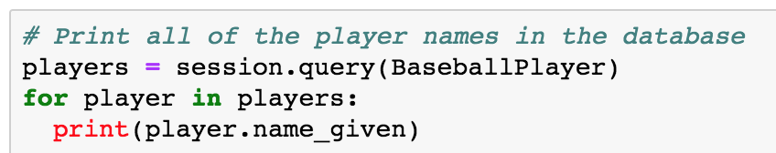
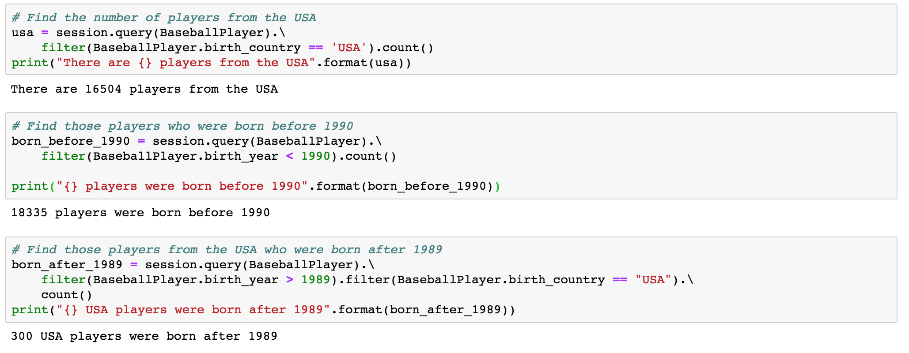
Code Exploration
(01-Ins_Basic_Querying /)
This Dataset contains over 1000 rows of data which can be searched through.
To query a database for all of the records in a specific table, use session.query() and pass the SQLAlchemy class that is associated with the table through as a parameter.
To create a query that looks into a specific column and selects only that data that passes a logic test, use the session.query(<SQL Class>).filter() method. When using this method, pass the class and column to query using dot notation and follow this with the test to perform.
Want to query multiple columns using and/or? use or_() or and_() within the filter method and passing multiple logic tests in as parameters.

Slide 4
Partner Do (Together)
(02-Stu_SharkSearch – 20 min) Instructions
Create a new table within your database called "SharkSearch" and run the SQL code provided within SQLPro or MySQL Workbench
Within a Python script, create a "Sharks" class that will be able to read all of the columns in from the table you created
Using SQLAlchemy, perform the following queries...
Print all locations of shark attacks
Find the number of provoked attacks
Find the number of attacks in the USA
Find the number of attacks in 2017
Find the number of attacks while surfing
Find the number of fatal shark attacks in 2017 in Australia

Slide 5
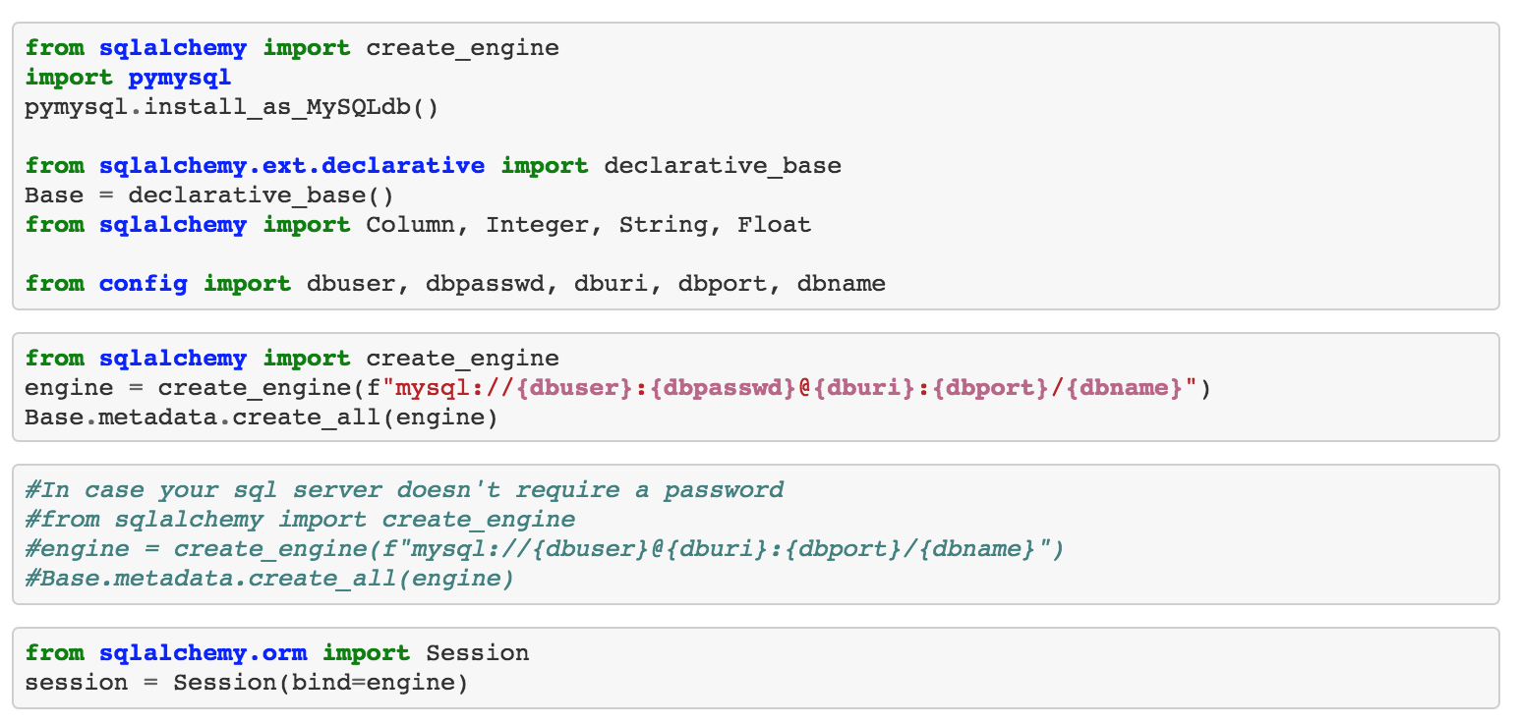
Review
(02-Stu_SharkSearch)

Slide 6
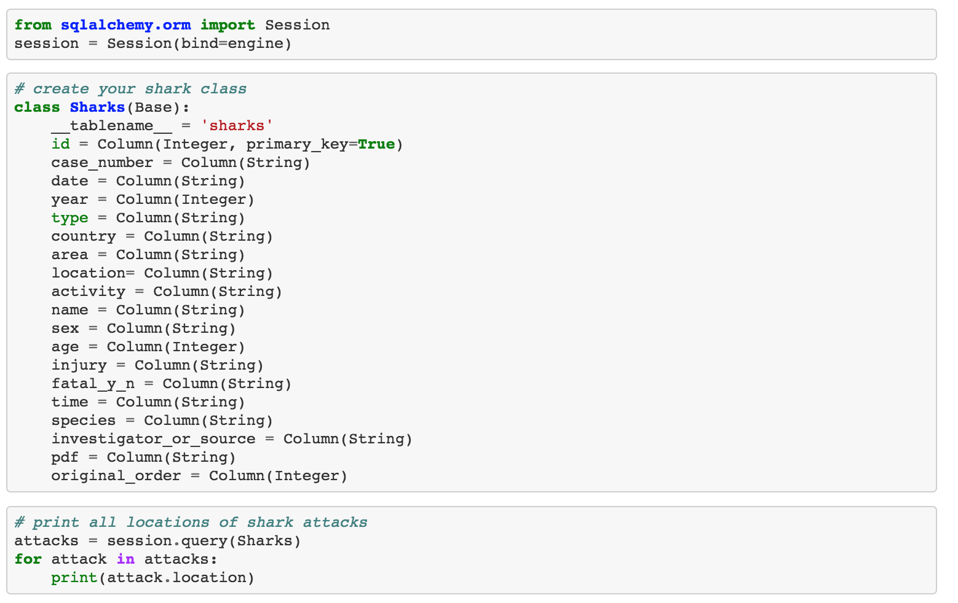
Review
(02-Stu_SharkSearch)

Slide 7
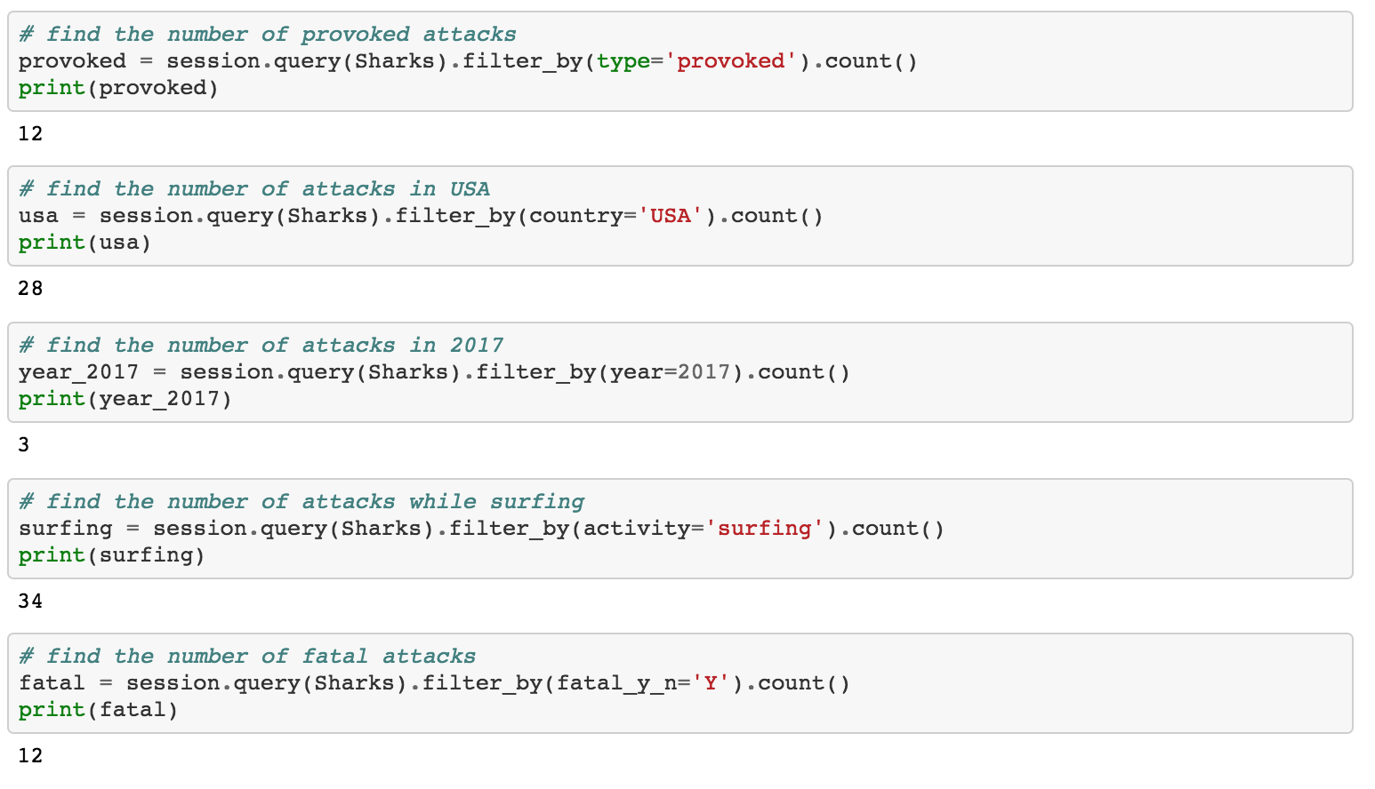
Review
(02-Stu_SharkSearch)

Slide 8
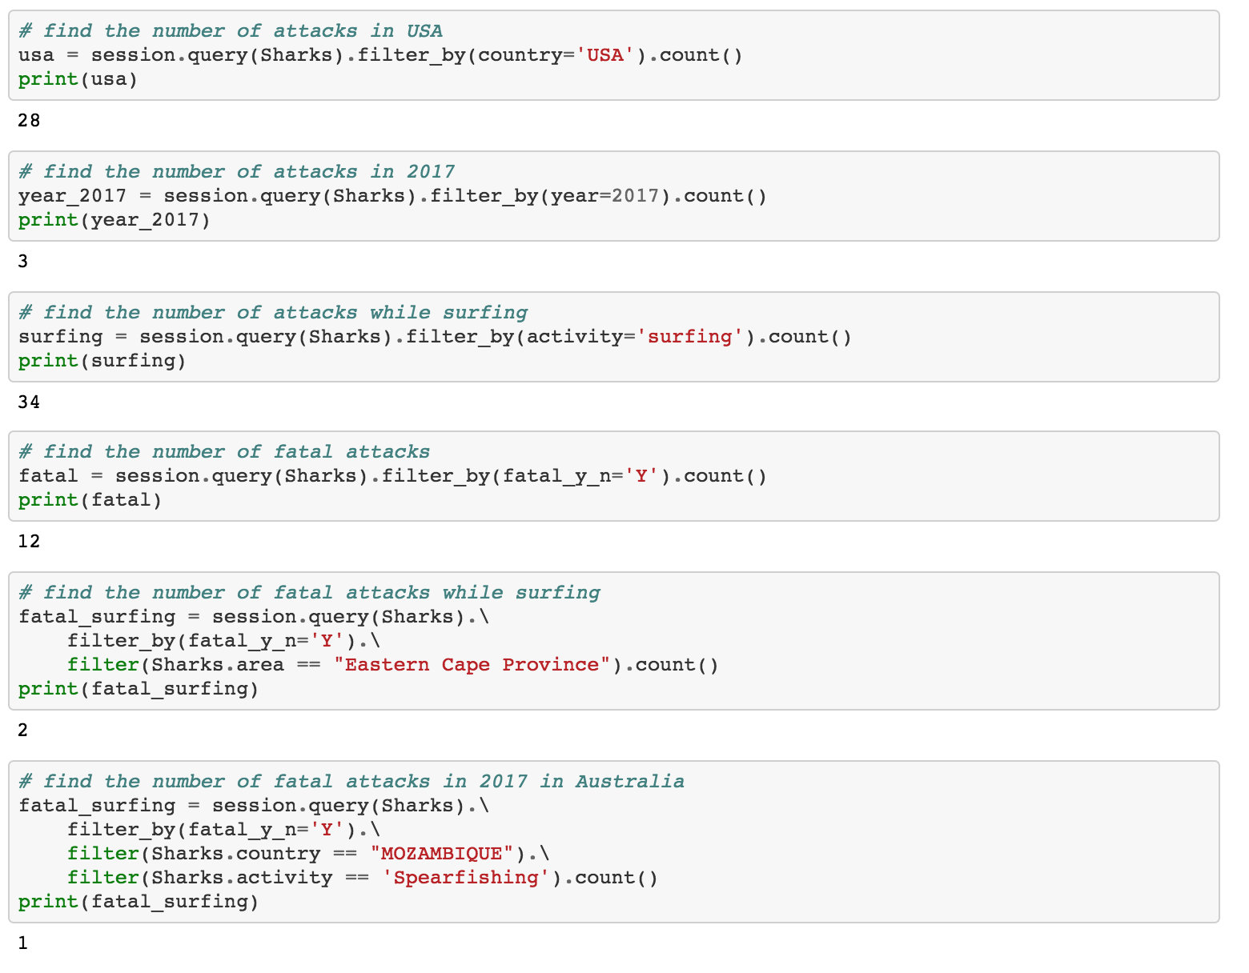
Review
(02-Stu_SharkSearch)

Slide 9
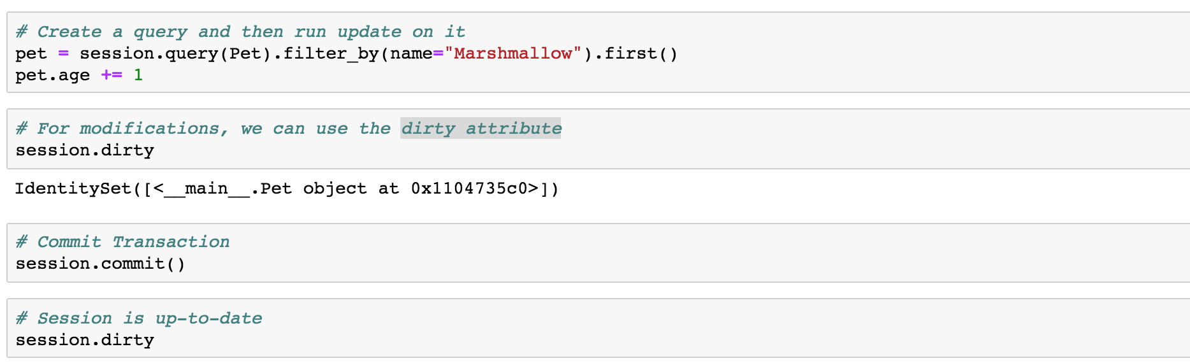
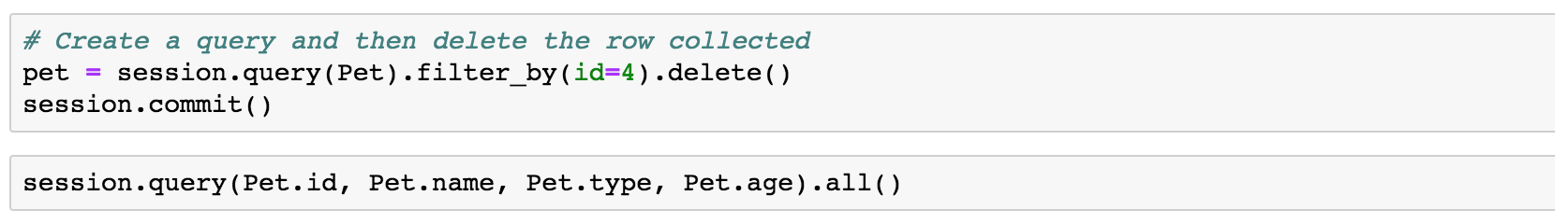
Code Exploration
(03-Ins_Basic_Updating /)
Updating Rows
.first() is used as well. Without the use of this additional method, the changes will not be made.
Since the record already exists within the external database, there is no need to perform as session.add(). Developers instead only need to use session.commit() to update the rows in the table.
Deleting Rows
add the .delete() method onto the end of the query statement.
Make sure to session.commit() for the delete to take effect.

Slide 10
Partners Do (Together)
(04-Par_CruddyDB – 20 min) Instructions
Within a Python file, create new SQLAlchemy class called Garbage that holds the following values...
__tablename__: Should be "garbage_collection"
id: The primary key for the table that is an integer and automatically increments
item: A string that describes what kind of item was collected
weight: A double that explains how heavy the item is
collector: A string that lets users know which garbage man collected the item
Create a connection and a session before adding a few items into the SQLite database crafted.
Update the values within at least two of the rows added to the table.
Delete the row with the lowest weight from the table.
Print (Read) out all of the data within the database.
Bonus:
Modify the application so that items can be added, updated, queried, or removed according to user inputs.

Slide 11
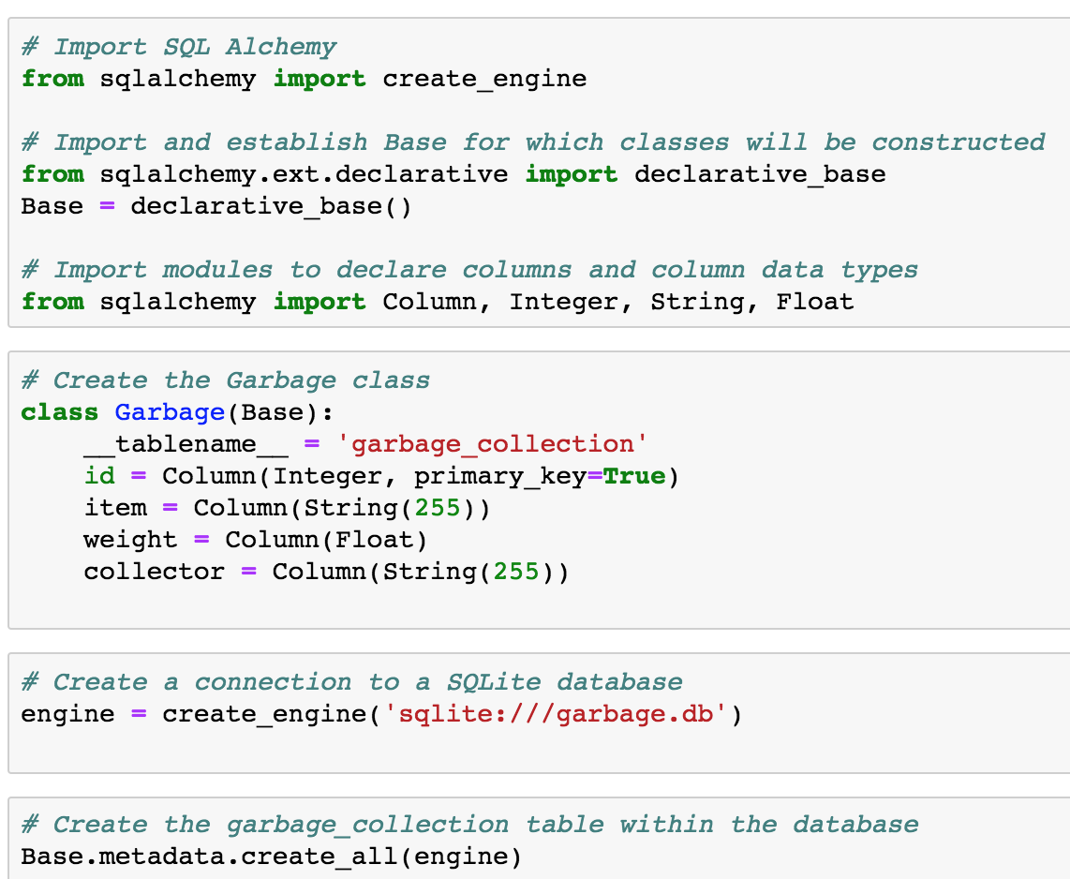
Review
(04-Par_CruddyDB)

Slide 12
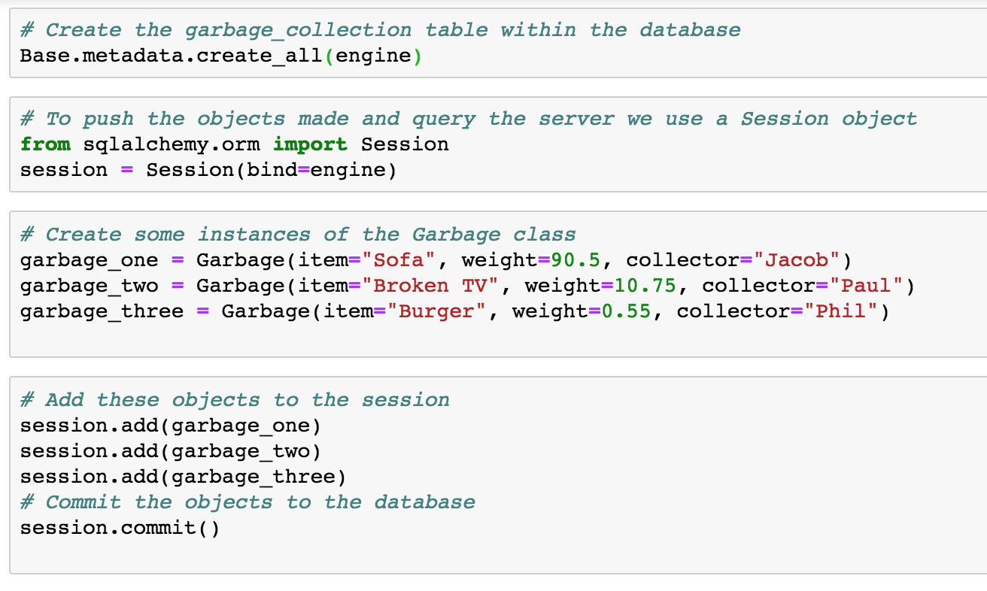
Review
(04-Par_CruddyDB)

Slide 13
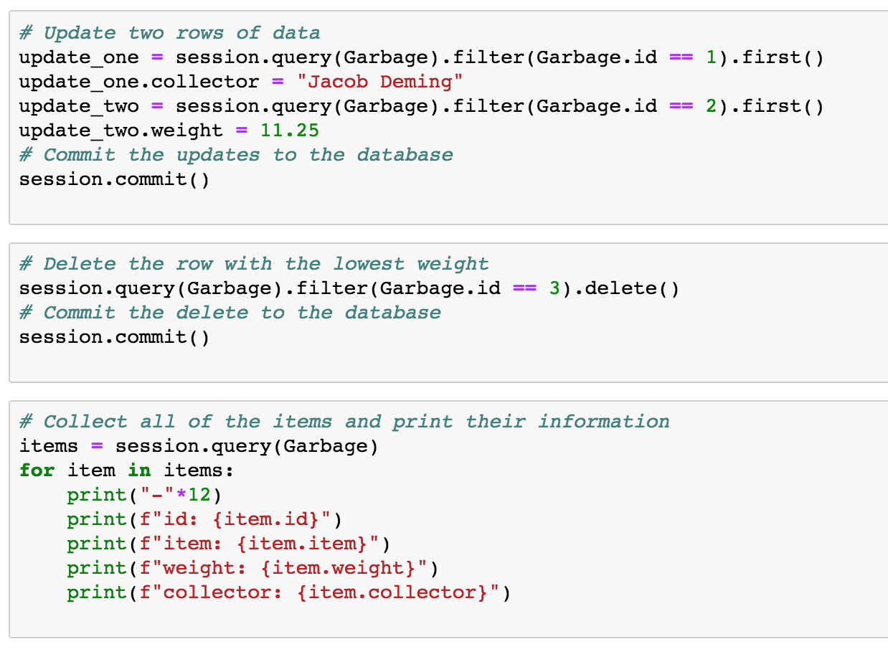
Review
(04-Par_CruddyDB)

Slide 14

Return in 15 Minutes
(~8:05pm)

Slide 15
Code Exploration
(05-Ins_Reflection /)
Often need to analyze already existing data sources. This would mean having to create SQLAlchemy classes according to a table's columns by hand every single time.
Creating ORM classes from an existing Database
Tools will load the data from an existing database and use that data to infer how to write ORM classes for use "automagically".
This process is called reflection.
STEPS
First, import automap_base in from the SQLAlchemy library
Then, create an engine against the existing database that should be reflected
Next, create a Base by calling Base = automap_base()
Finally, call Base.prepare with the engine from Step 2 and reflect=True as its parameters

Slide 16
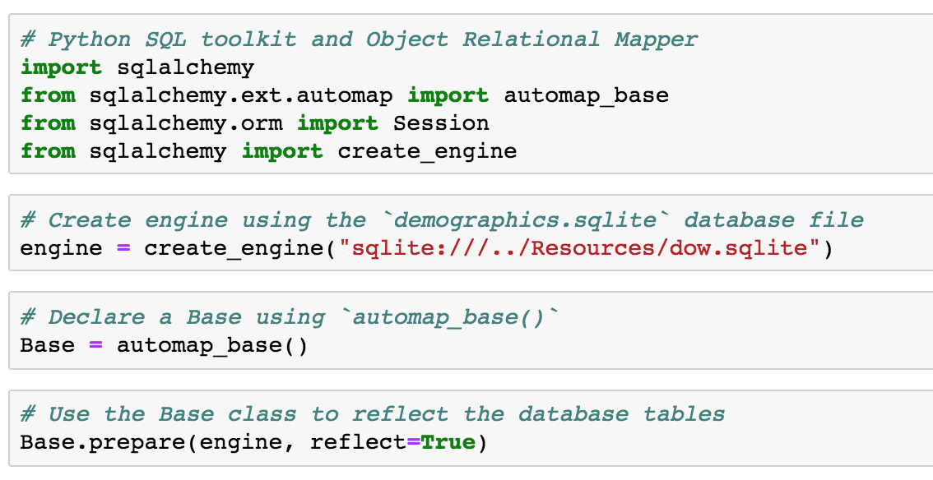
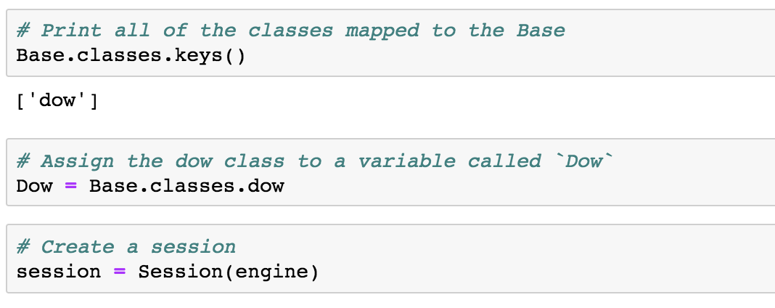
Code Exploration
(05-Ins_Reflection/)
automap_base is similar to declarative_base but creates a different Base class with additional features.
the class returned by automap_base has a prepare method, which will "automagically" reflect the data in an existing database.
It is possible to view the automagically generated ORM classes by examining Base.classes.keys()
These keys will share the name of the underlying database tables they represent.
It is possible to access these classes via dot notation: <ExampleClassName> = Base.classes.<ExampleClassName>

Slide 17
Code Exploration
(05-Ins_Reflection/)
automap_base is similar to declarative_base but creates a different Base class with additional features.
the class returned by automap_base has a prepare method, which will "automagically" reflect the data in an existing database.
It is possible to view the automagically generated ORM classes by examining Base.classes.keys()
These keys will share the name of the underlying database tables they represent.
It is possible to access these classes via dot notation: <ExampleClassName> = Base.classes.<ExampleClassName>

Slide 18
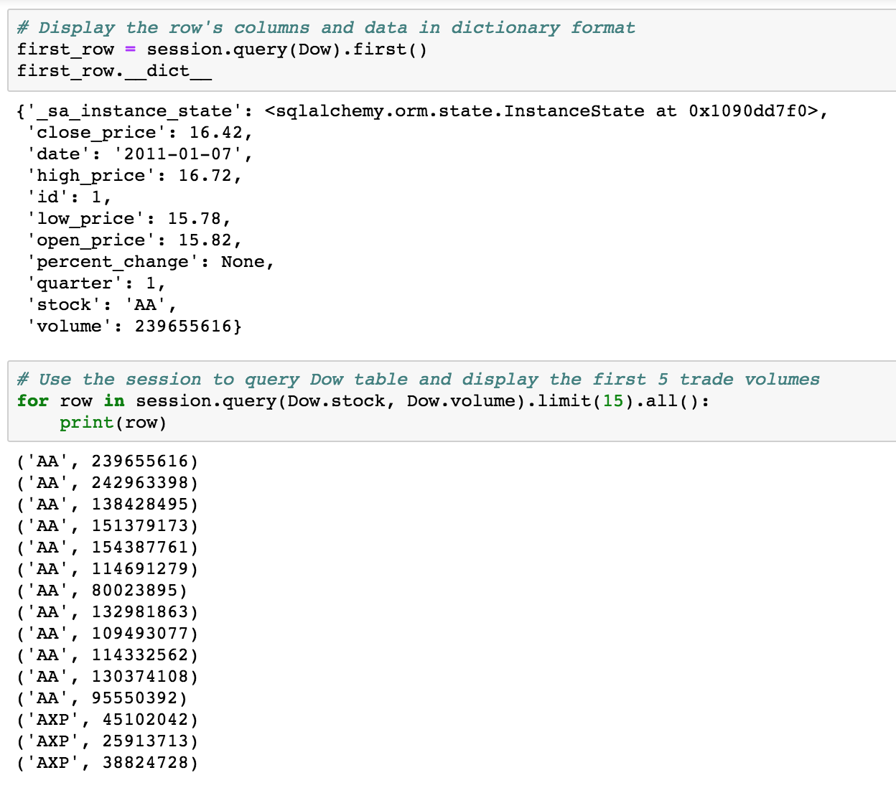
Code Exploration
(05-Ins_Reflection/)
automap_base is similar to declarative_base but creates a different Base class with additional features.
the class returned by automap_base has a prepare method, which will "automagically" reflect the data in an existing database.
It is possible to view the automagically generated ORM classes by examining Base.classes.keys()
These keys will share the name of the underlying database tables they represent.
It is possible to access these classes via dot notation: <ExampleClassName> = Base.classes.<ExampleClassName>

Slide 19
Students Do (Solo)
(06-Stu_ReflectingOnSQL – 20 min) Instructions
Create engine using the demographics.sqlite database file
Declare a Base using automap_base() and use this new Base class to reflect the database's tables
Assign the demographics table/class to a variable called Demographics
Create a session and use this session to query the Demographics table and display the first five locations
Bonus:
Query and print the number of unique locations in the table.
Hint:
For the bonus, look into counting and grouping operations in SQLAlchemy

Slide 20
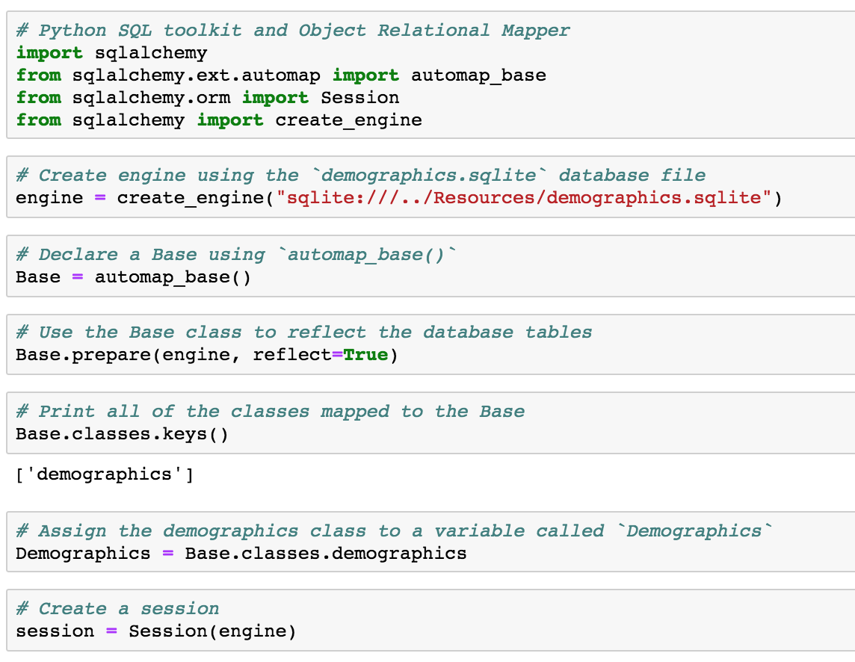
Review
(06-Stu_ReflectingOnSQL)
Base is instantiated with automap_base as opposed to declarative_base. Base.prepare() is then called, passing the SQL connection engine and the keyword argument reflect=True so as to create a reflection of the existing database.
A list of all of the reflected tables can be collected using Base.classes.keys()
The class associated with a given table can be collected by referencing the appropriate property within Base.classes

Slide 21
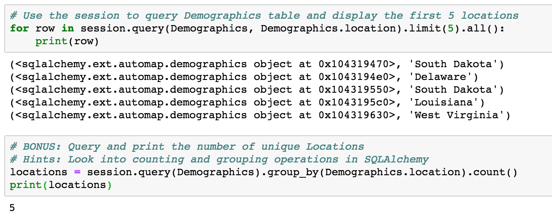
Review
(06-Stu_ReflectingOnSQL)
The Bonus
group_by allows one to "collapse" results that share a particular column value and then count can be used to count the number of rows returned by the query.
The query first creates a set for each demographic location that appears within the database and then counts the number of sets returned, thus yielding the number of unique locations represented in the database.

Slide 22
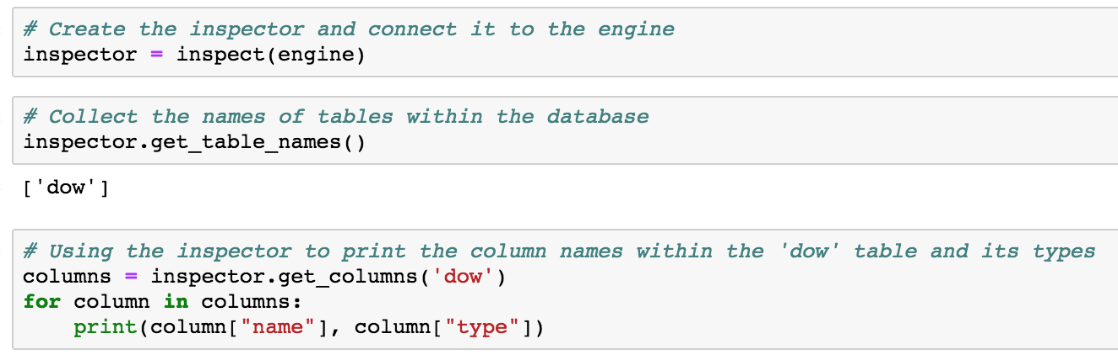
Code Exploration
(07-Ins_Exploration /)
In order to collect information on what is stored, developers would want to look into the columns for a table and their associated datatypes.
In order to collect that kind of information, developers would want to look into the columns for a table and their associated datatypes.
The inspector tool allows SQLAlchemy developers to look through a connected database and explore its contents.
The inspector is primarily used to look up tables, columns, and datatypes. Looking up the specific values stored within a table is where queries should be used.

Slide 23
Students Do (Solo)
(08-Stu_SalaryExplore SQL – 10 min) Instructions
Using the attached SQLite file, use an inspector to collect the following information...
The names of all of the tables within the database.
The column names and data types for the Salaries table.
Reflect the database, create a session, and query the Salaries table to collect the number of salaries that are over 50k per year.

Slide 24
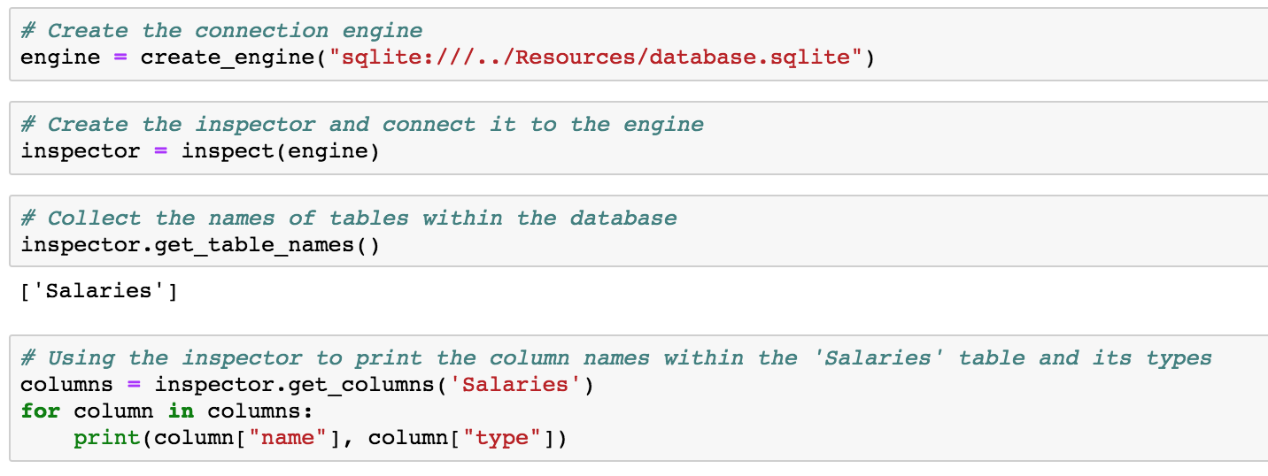
Review
(08-Stu_SalaryExplore SQL)

Slide 25
Partners Do (Together)
(09-Par_EmojiPlotting– 30 min) Instructions
Use the inspector to explore the database and print out the table names stored within it.
Using the inspector, print out the column names and types for each of the tables contained within the SQLite file.
Reflect the database into a SQLAlchemy class and start a session that can be used to query the database.
Using Matplotlib, create a horizontal bar chart and plot the emoji score in descending order. Use emoji_charas the y-axis labels and plot only the top 10 emojis ranked by score
Create the same kind of chart using Pandas to plot the data instead of Matplotlib.

Slide 26
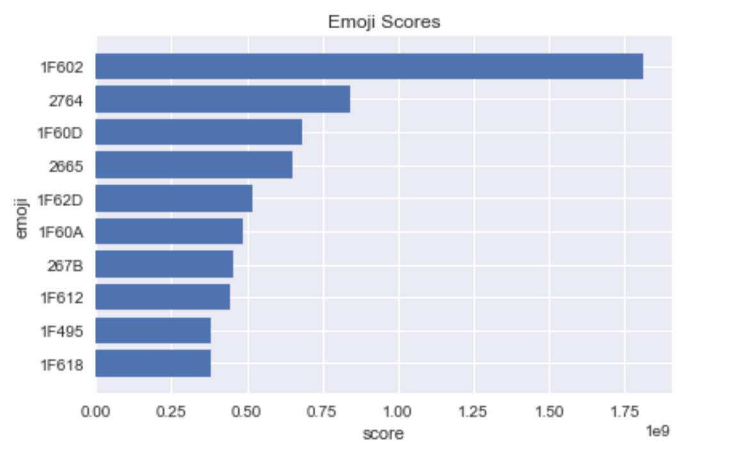
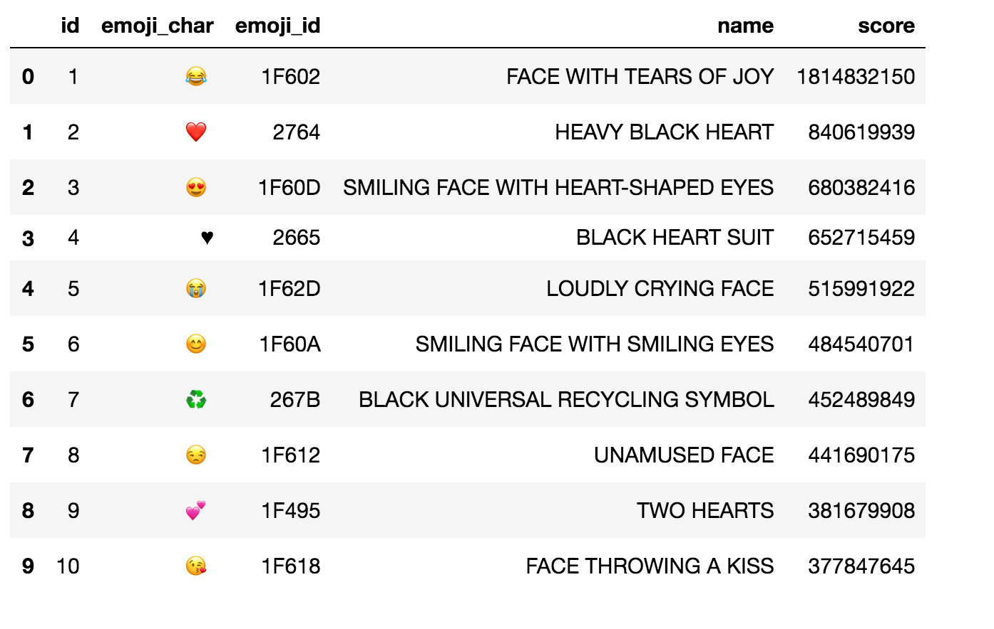
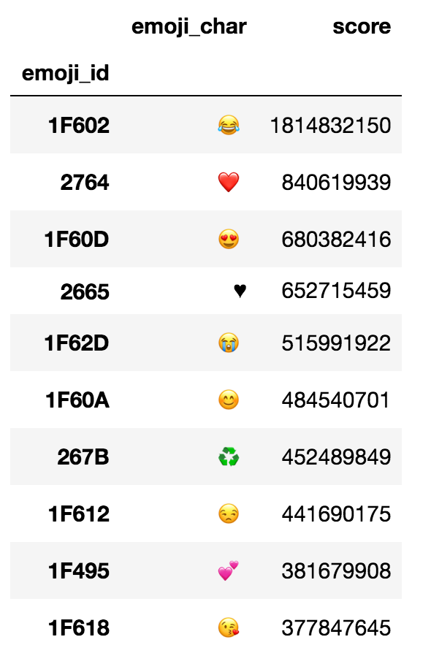
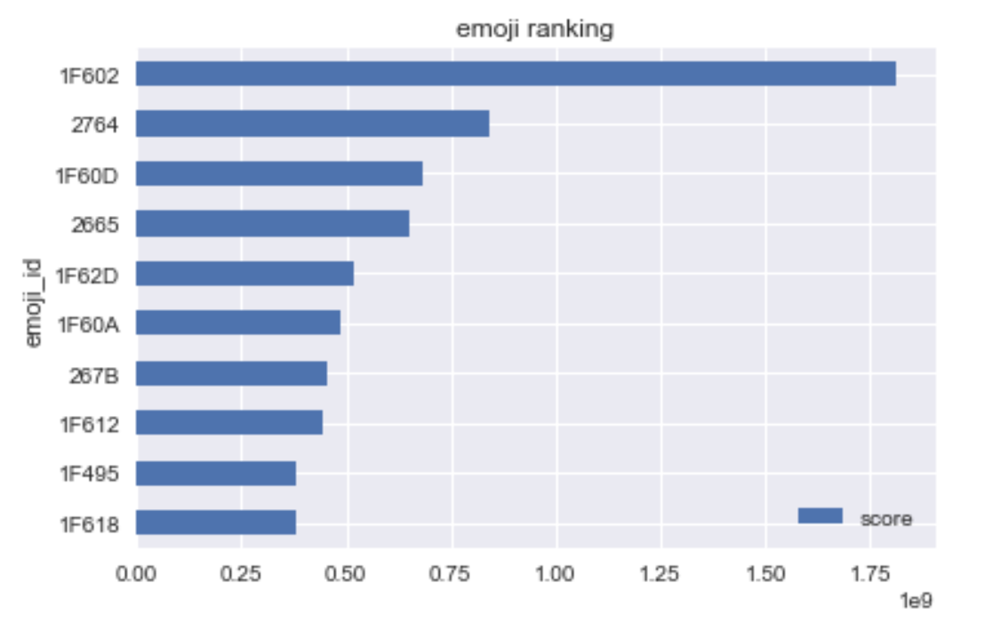
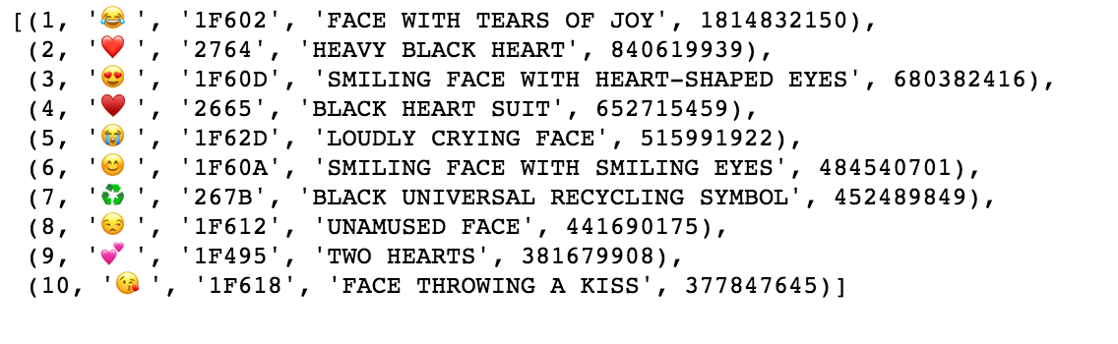
Partners Do (Together)
(09-Par_EmojiPlotting)

Slide 27
Review
(09-Par_EmojiPlotting)

Slide 28
Questions

